Slide 1
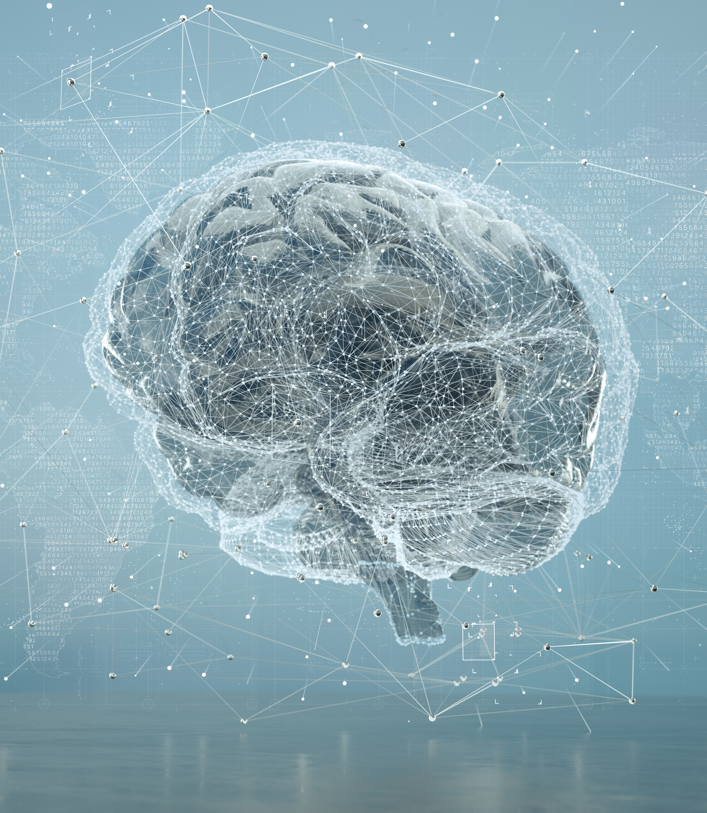

Use of Machine Learning in Default Prediction

Slide 2


Who are we and why we are here
We are One-D consulting, and we are here to help BestCard predict credit defaulters using Machine Learning techniques.
Mariappan, B. (2023, February 13). Data Mining: A Search for Hidden Gold. Triyam. https://www.triyam.com/blog/data-mining-a-search-for-hidden-gold
Notes:
Notes to presenter:
What is your purpose for sharing this reflection?
Is it at the end of a unit or project?
Are you sharing this reflection, at the attainment of a learning goal you set for yourself?
Is it at the end of a course?
State your purpose for the reflection or even the purpose of the learning experience or learning goal. Be clear and be specific in stating your purpose.

Slide 3
Learning from Data to Predict Defaulters
We have tried multiple models on the data given to us by BestCard
Our models show significant ability to predict default risk among test cases.
By better predicting defaults, BestCard will be able to better position itself in the competitive credit card market.
BestCard will be able to avoid likely defaulters, or continue to offer services but at a higher risk premium.

Slide 4

Example of a bad model
Cost of Default¹: ($45,049)
Average 6 Month income: $31,830
Assume account close: ($200)
Guessing half, the time could cost²:
($88,170,905)
1: Data was aggregated from the card data given to us. Default costs are the average bill amount, and 6 Month income rates are the average payments multiplied by 6. The account close is a low value assumption for the cost to close an account.
2: Based on a 50/50 simulation with outcome values of TP: 405, TN: 4005, FP: 178, FN: 745

Slide 5
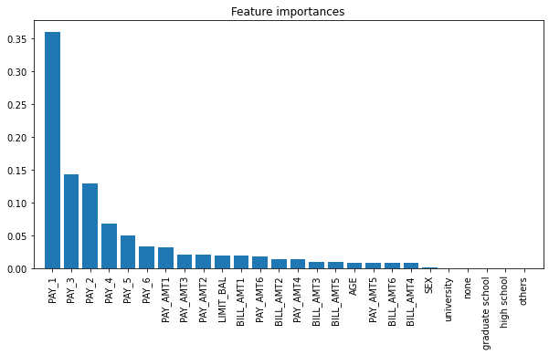
Importance of Feature sets
Some columns were more important than others.
Pay columns were critical to prediction
Random Forest Classifier
All major and minor columns
Other columns had minimal impact
Bill amount had a non-zero, but very small impact
Gradual removal of minor columns
Critical columns were the same between models
However, impact of non-critical models varied
Removal of Key Columns, Pay

Slide 6
4 Types of models were selected for testing
Random Forest Classifier
Support Vector Machine
Neural Network
K Nearest Neighbors (KNN)

Slide 7

Models Used and Metrics
Random Forest Classifier
Best Accuracy: 82.93%
AUC Score: 0.78
Ensembling Learning method combining multiple decision trees.
Support Vector Machine
Best Accuracy: 82.52%
AUC Score: 0.72
Finds a hyper-surface in the data set that best segments the data into classes.
Neural Network
Best Accuracy: 82.35%
AUC Score 0.75
A Neural Network built in Tensorflow, uses matrix operations and gradient decent to find optimum
KNN (k-Nearest Neighbors)
Best Accuracy 81.69%
AUC Score: 0.63
Classifier identifies unknown points by comparing distance to known points and matching to the majority of the "k" selected neighbors
Notes:
Notes to presenter:
What was important about this learning experience?
How is it relevant to your course, yourself, or your society or community?
Why is this significant?
This SmartArt allows you add images and text to help outline your process. If a picture is worth a thousand words, then pictures and words should help you communicate this reflection on learning perfectly! You can always click on Insert>SmartArt to change this graphic or select the graphic and click on the Design contextual menu to change the colors.

Slide 8

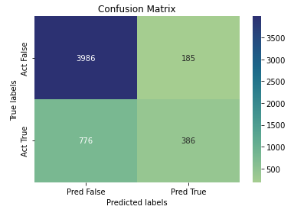
Neural Networks
Model has decent accuracy, but not the best
3rd best Accuracy of 82.35%
2nd best AUC of .765
Might be improved with additional hyper-parameter tuning.
Re-consider if the feature set includes more complex data.
Notes:
Notes to presenter:
Description of what you learned in your own words on one side.
Include information about the topic
Details about the topic will also be helpful here.
Tell the story of your learning experience. Just like a story there should always be a beginning, middle and an end.
On the other side, you can add a graphic that provides evidence of what you learned.
Feel free to use more than one slide to reflect upon your process. It also helps to add some video of your process.

Slide 9

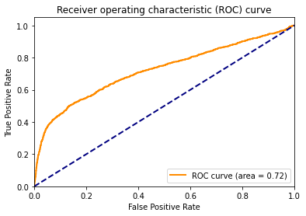
Support Vector Machine
Model with the next best accuracy
2nd Best Accuracy 82.52%
3rd Best AUC of 0.72
Reasons to consider
Good for higher dimensional data
Simple to understand
Not good for very mixed data

Slide 10

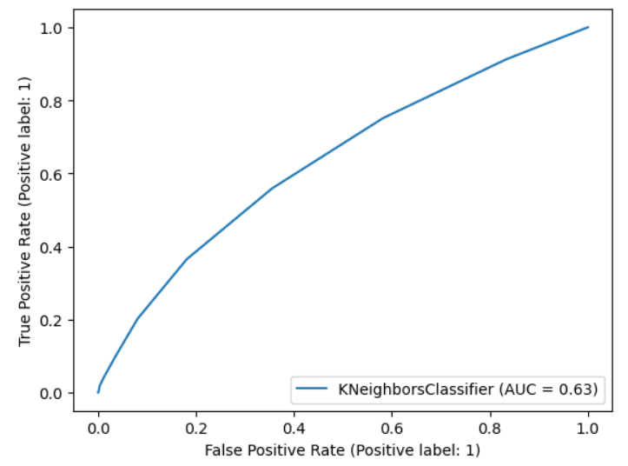
K Nearest Neighbors (KNN)
Model Accuracy is 81.69%
AUC of 0.63
Reasons to choose this model:
Similarity-based
No assumptions
Easy to interpret
Notes:
Notes to presenter:
Description of what you learned in your own words on one side.
Include information about the topic
Details about the topic will also be helpful here.
Tell the story of your learning experience. Just like a story there should always be a beginning, middle and an end.
On the other side, you can add a graphic that provides evidence of what you learned.
Feel free to use more than one slide to reflect upon your process. It also helps to add some video of your process.

Slide 11

Random Forest Classifier
Blackbox solution, hard to explain why it works so well.
Final prediction is made by aggregating the predictions of all decision trees, by taking a simple majority vote
Best accuracy of all the models
82.93% vs 82.52% (Next Best)
$89,614,682 vs $87,786,075
Additional Lift: $1,828,607
2: Based on two simulations with a default rate of 22.18% and accuracy of 82.93% and 82.52%:
82.52% TP: 387, TN: 4036, FP: 168, FN: 742
82.93% TP: 395, TN: 4006, FP: 177, FN: 755
Notes:
Notes to presenter:
Description of what you learned in your own words on one side.
Include information about the topic
Details about the topic will also be helpful here.
Tell the story of your learning experience. Just like a story there should always be a beginning, middle and an end.
On the other side, you can add a graphic that provides evidence of what you learned.
Feel free to use more than one slide to reflect upon your process. It also helps to add some video of your process.

Slide 12

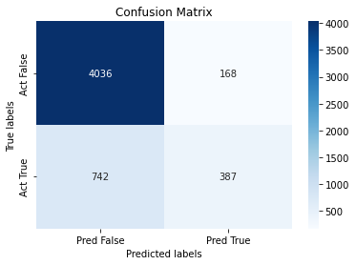
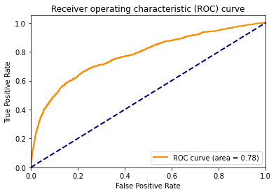
Random Forest Classifier Model
Confusion Matrix
ROC Curve
Feature Importance
Notes:
Notes to presenter:
Description of what you learned in your own words on one side.
Include information about the topic
Details about the topic will also be helpful here.
Tell the story of your learning experience. Just like a story there should always be a beginning, middle and an end.
On the other side, you can add a graphic that provides evidence of what you learned.
Feel free to use more than one slide to reflect upon your process. It also helps to add some video of your process.

Slide 13

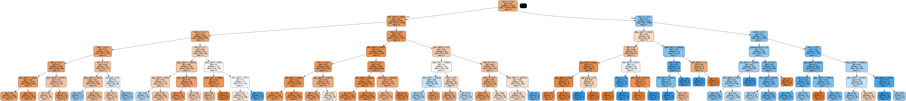
Random Forest Classifier
Insights:
Ability to handle non-linearity
High-dimensionality
Ability to handle mixed data types
Robustness & versatility
Feature importance rankings
Can capture complex nonlinear relationships between features and target variables

Slide 14

What Steps Are Needed to Deploy 1D’s Solution?
Determine frequency of API request: Weekly, Daily, Hourly, more?
4
Cloud solution or in house servers?
3
2
Setup monitoring operations.
1
Review model and continually improve.
Notes:
Notes to presenter:
What steps will you be taking as a result of this learning experience?
Did you learn from any failed experiences? How will you do things differently?
What advice will you give to others so they can learn from your experiences?
How can you share what you learned with a real-world audience?
Some examples of next steps might be:
After delivering my first persuasive presentation, I am thinking about joining the debate team.
After making my first film, I’m considering entering it in our school film festival or local film festival.
After connecting with this career expert, I’d like to do some research on that career field because it sounds interesting to me.
This SmartArt allows you add images and text to help outline your process. If a picture is worth a thousand words, then pictures and words should help you communicate this reflection on learning perfectly! You can always click on Insert>SmartArt to change this graphic or select the graphic and click on the Design contextual menu to change the colors.
Feel free to use more than one slide to share your next steps. It also helps to add some video content to explain your message.

Slide 15
Q & A

